Slide 1
Boolean algebra and clausal form

Slide 2
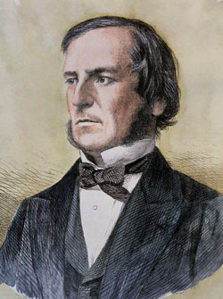
Boolean algebra
George Boole realized in the mid-19th century
That logic behaves in some ways like numbers algebra
The result is now called Boolean algebra
And truth values in programming languages are usually called “Booleans”

Slide 3
Algebra in high school
There are numbers
You can add and multiply them
And subtract and divide, but that’s not relevant for our purposes
Algebra is about the special properties of these operations
How to can use those properties to
Manipulate expressions into more useful forms

Slide 4

Commutativity and associativity
Addition and multiplication are commutative
$x+y=y+z$
$x×y=y×x$
Addition and multiplication are associative
$(x+y)+z = x+(y+z)$
$\left(x×y\right)×z = x×(y×z)$
Together, these mean you rearrange a sequence of additions (or multiplications) as you like

Slide 5

Distributivity
Multiplication distributes over addition
This just means we can push $×$ inside of $+$ (or move it outside)
$x×\left(y+z\right)=\left(x×y\right)+\left(x×z\right)$
We can also use it to pull multiplications out
But that’s not relevant for us here

Slide 6

Distributivity
By repeatedly pushing $×$ inside of $+$
We can rearrange any combination of $×$ and $+$ into a sum of multiplications
$\left(x×\left(y+z\right)\right)×\left(x+y\right)$ $=\left(x×y+x×z\right)×\left(x+y\right)=\left(\left(x+y\right)×\left(x×y\right)\right)+\left(\left(x+y\right)×\left(x×z\right)\right)=\left(x×x×y\right)+\left(y×x×y\right)+\left(x×x×z\right)+\left(y×x×z\right)$
We usually rewrite this in terms of powers
$\left(x^{2}×y\right)+\left(y^{2}×x\right)+\left(x^{2}×z\right)+\left(y×x×z\right)$
Or, removing the multiplication signs: $x^{2}y+xy^{2}+x^{2}z+xyz$
But these are just different notations for lots of multiplications

Slide 7
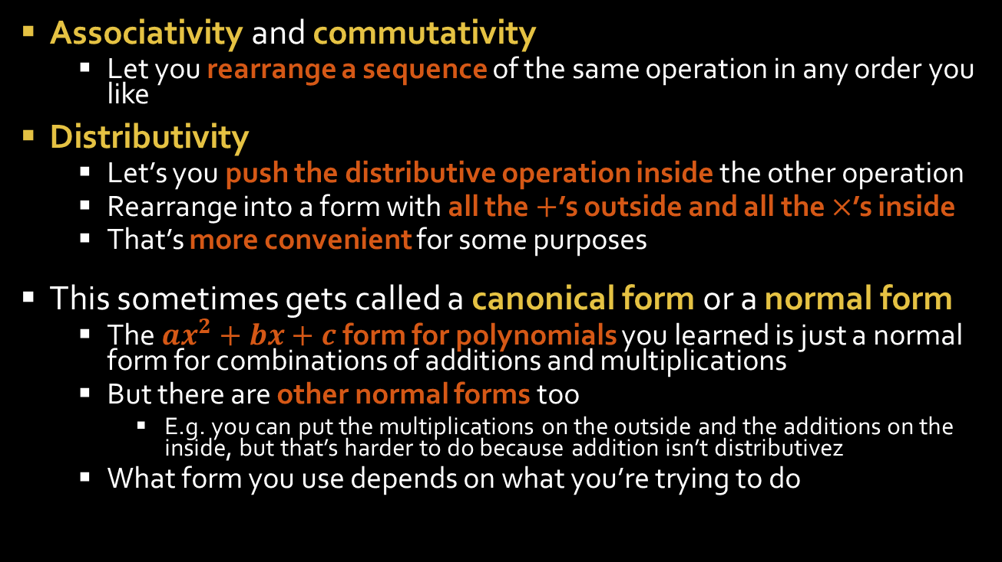
Summary
Associativity and commutativity
Let you rearrange a sequence of the same operation in any order you like
Distributivity
Let’s you push the distributive operation inside the other operation
Rearrange into a form with all the $+$’s outside and all the $×$’s inside
That’s more convenient for some purposes
This sometimes gets called a canonical form or a normal form
The $ax^{2}+bx+c$ form for polynomials you learned is just a normal form for combinations of additions and multiplications
But there are other normal forms too
E.g. you can put the multiplications on the outside and the additions on the inside, but that’s harder to do because addition isn’t distributivez
What form you use depends on what you’re trying to do

Slide 8
Algebraic manipulation of classical logic

Slide 9
Classical propositional logic
Syntax (grammar)
A statement is
A proposition (any word or symbol you want to make up)
“not” followed by a statement
Two statements connected by “and” or “or”
Use parentheses for disambiguation
Semantics
A truth assignment is gives truth values to propositions
A truth assignment is a model of a statement if the statement is true when you plug in its truth values

Slide 10
Truth tables
A | B | A or B
F | F | F
F | T | T
T | F | T
T | T | T*
A | B | A and B
F | F | F
F | T | F
T | F | F
T | T | T
* There are really two versions of “or”:
Inclusive or
“either, or both”
T or T = T
Exclusive or
“either, but not both”
T or T = F
Both get used, but inclusive or is much more common and it’s what well use in class.
A | not A
F | T
T | F

Slide 11
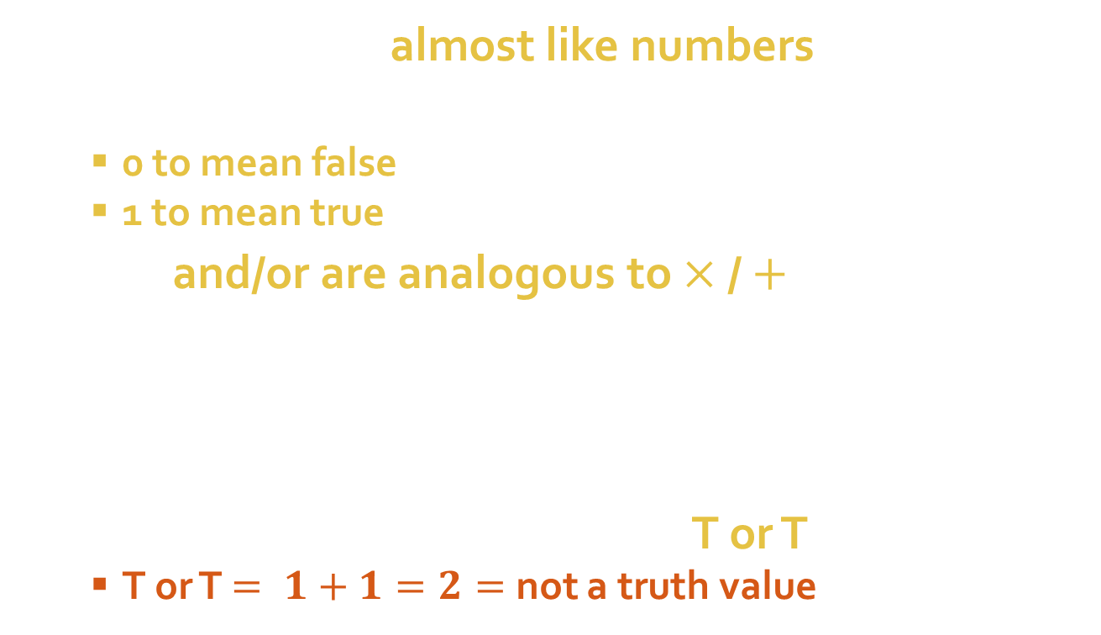
Guess what?
Truth values are almost like numbers
If we use
0 to mean false
1 to mean true
Then and/or are analogous to $×$ / $+$
T and T $= 1×1=1=$ T
T and F $= 1×0=0=$ F
T or F $= 1+0=1=$ T
F or F $=0+0=0=$ F
The only hiccup is when we say T or T:
T or T $= 1+1=2=$ not a truth value

Slide 12

And / or mostly behave like $×$ / $+$
Associative
(A and B) and C) = A and (B and C)
(A or B) or C) = A or (B or C)
Commutative
A and B = B and A
A or B = B or A
And distributes over or
A and (B or C) = (A and B) or (A and C)

Slide 13


And / or are better behaved than $×$ / $+$
The fact that or is a little different from $+$ means you can manipulate it in more powerful ways
Or distributes over and
A or (B and C) = (A or B) and (A or C)
And / or are interconvertible (DeMorgan’s law), with liberal use of nots
A and B = not ((not A) or (not B))
“A and B is true” means the same as “neither A nor B is false”
A or B = not ((not A) and (not B))
“A or B is true” means the same as “A and B can’t both be false”

Slide 14
Clausal forms

Slide 15
Normal forms
The fact that and / or distribute over one another means we can push/pull either one inside or outside the other
This gives us two normal forms that are really useful
Both sort and/or/not to be in a specific order
Not always innermost operation
These normal forms are
ORs of ANDs (aka disjunctive normal form, DNF)
(x and y) or (y and not z)
Each group of ands gives a sufficient condition for the whole thing being true
They are jointly necessary – it’s not true unless one of them is true
ANDs of ORs (aka conjunctive normal form, CNF)
(x or not y) and (y or not z)
Each group of ors is a necessary condition
Each item in a group of ors is sufficient for its group
Most automated reasoning systems use one of these forms
Whatever information you give it, it translates it into its preferred normal form

Slide 16
Conjunctive normal form
Most AI systems use some variant of ANDs of ORs, aka conjunctive normal form
A big AND
Of a bunch of ORs
Of a bunch or propositions or NOTs of propositions (i.e. A or not A)
So important, there’s special terminology for them
A literal is anything without ANDs or ORs
Proposition (A, B, C)
Negation of a proposition (not A, not B, not C)
A clause is an OR of a bunch of literals
A or (not B) or C
CNF is just an AND of a bunch of clauses

Slide 17
Who cares?
Easy to understand
What, what?
While CNF looks intimidating, individual clauses can be naturally interpreted as if/then rules, which humans find much more natural
We’ll talk about if/then rules in the next lecture
Useful for model finding
Nearly every SAT solver uses CNF
Including Imaginarium
Including the huge ones that companies like Intel use to look for bugs in their chip designs
Millions of propositions and clauses
We’ll talk about model finding in the lecture after that
Useful for inference
Because clauses can be interpreted as implications
They generalize all the inference rules about implications
So clausal form is used for virtually all AI reasoning systems
And we’ll talk about inference in the lecture after that

Slide 18
How Imaginarium works
Convert English into clauses in classical propositional logic
Find a model of the clauses
Randomly assign truth values to propositions
Count true literals in each clause
The clauses with 0 are false, the others are true
We want to make them all true, so
Repeat
Pick a false clause
Pick a literal in it
Flip it’s truth value
Now the clause is true
But maybe just made others false
So keep going until all clauses are true
Convert model back into English and print it out

